Slide 1
Class Diagrams

Slide 2
Object-Oriented Development
In [1] we find the following definition of object-oriented programming:
“A program execution is regarded as a physical model, simulating the behavior of either a real or imaginary part of the world.”
The model should reflect the selected parts of the world which is modeled, or put another way it should reflect over perception of it.
It seems that the object-oriented concepts (object, class, ..), coincides with the way our mind organize knowledge.

Slide 3
Class and Type [3]
Type a set of objects or values with similar behavior, usually expressed by the operations defined on the type, without regard for the potential implementation of the type. A type is a semantic property.
Class a description of a group of objects with similar properties, common behavior, common relationships, and common semantics.
When you talk about types you talk about operations, when you talk about class you talk about methods. A class is an implementation of a type, so a method is an implementation of an operation.

Slide 4
Perspectives[2]
Conceptual: The concepts of the problem domain are addressed. The class diagrams produced under the analysis will typically be of the conceptual type. The diagrams are not tied to any software implementation.
Specification: This perspective is closer to software. Interfaces is specified, but not the implementation. It is said that types are specified and not classes. This perspective is typically employed under design.
Implementation: The class diagrams produced will reflect the classes that is to be implemented.

Slide 5
Class
An object has three characteristics: state, behavior and a unique identification.
A class is a template for instantiation of objects. A class diagram contains an attribute (state) and a method (behavior) section:
Class Name
attribute: Type = initialValue
....
method(arg list): return type
....
The level of and the numbers of details in the class diagram can vary, this depends on where you are in the development process. It is for example usual to leave the method section out under analyses.

Slide 6
Attribute
[5] ”An attribute is the description of a named slot of a specified type in a class; each object of the class separately holds a value of the type.”
<<sterotype>>_{opt} visibility_{opt} name multiplicity_{opt} : type_{opt} = initial-value_{opt} {property-string}_{opt}
E.g. <<unique>>
Example:
Tagged value e.g.
Author = Kari
- (private) only the class can see
this attribute
# (protected) only the class and
all of its subclasses
+ (public) all classes that can see
the class can also see
the attribute
Example: email[1..*] :String
Indicating one or more email addresses.
If no email is present you will still have a
the empty string (””).
If email[0..*] : String is specified, the email
can be null.

Slide 7
UML instance-scope /
class-scope 1
[1]: ”... an attribute may be distinct in each object or it may be shared by all objects of a class. The former is an instance-scope; the latter is a class-scope attribute. Most attributes are instance-scope; they carry state information about a particular object. Class-scope attributes carry information about an entire class; there is a single value for the entire class. ...”

Slide 8
UML instance-scope /
class-scope 2
Attribute int2 and int3 are marked as class-scoped, class-scope is indicated by underlining.
int3 is class-scoped, often “frozen” attributes are made class-scoped.
Method getInt2 is class-scoped; it can only access class-scoped attributes and methods.
MyClass
int3 is marked as frozen,
which indicates that int3
can not be changed after
initialization.
- int1 : int = 10
- int2 : int = 20
- int3 : int = 30 {frozen}
+ method()
+ getInt2() : int
public class MyClass{
private int int1=10;
private static int int2 = 20;
private static final int int3 = 30;
public void method1(){ int1 = 20;};
public static int getInt2(){ return int2;};
}
Corresponding Java class!

Slide 9
Operation
[5]: ”An operation is a specification of a transformation or query that an object may be called to execute….A method is a procedure that implements an operation. It has an algorithm or procedure description.”
Examples:
+ <<query>> getX() : double
+setX(newX : double)
<<sterotype>>_{opt} visibility_{opt} name(parameter-list) multiplicity_{opt} : return-type_{opt}
{property-string}_{opt}

Slide 10
Substitutability
The property that one object can be substituted with another object, the other object is typically of another type.
The generalization relationship should supports substituability!
Example: If you have a decleration of a variable of type X, the actual value could be an object of type Y, where Y is a subclass of X. This should not change the semantics or the use of this variable!
If the substitutability principle is to apply, the programmer must assure that subclasses don’t remove or renounce properties of its parent class.

Slide 11
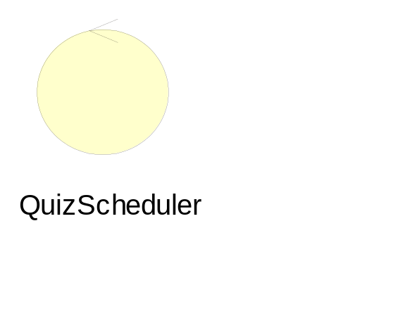

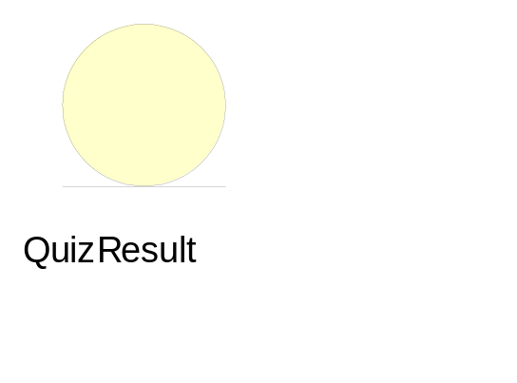
Class Stereotypes
Control Class: Manage interactions. Its
behavioir is specific to a use case, which it
usally does not outlive.
Boundary Class: Mediate between the
system and outside actors (e.g. sensor).
Often their lifeline coincide with the life
of the system.
Entity Class: Passive objects, they do not
initiate interactions. May participate
several use cases.

Slide 12
Robustness Diagram Rules
Allowed
Not Allowed

Slide 13
The Three Most Important Relationships In Static Modeling
Generalization
Base
sub
Association
Class1
Class2
Dependency
Class1
Class2

Slide 14
Generalization
Also called generalization/specialization.
Example: birds are animals, were birds are the most specialized and animals the most general.

Slide 15
Generalization used in class diagrams
superclass
Animal
generalization arrow
subclass
subclass
Bird

Slide 16
Association
A relationship that describes a set of links between classes of objects, indicating some sort of connection between objects of the involved classes.
Example: student follows a course.
In UML class diagrams you can distinguish between ordinary association, simple aggregation and composition (strong aggregation).

Slide 17
Navigability
If you have a Quiz-object, the associated Question-objects can be directly reach from the Quiz-object. You will typically find a reference of each object inside the Quiz-object.
Quiz
Direction of navigation
Question
*
1..*
ordinary association
One possible mapping to Java
class Quiz{
// A list of questions
Question [] questions;
....
}
class Question {
// no reference to Quiz
....
}

Slide 18
More on Navigability
When navigability is true, you can use the rolename (given at the arrowhead) as an attribute of the base class.
E.g.(Java): rightAnswer.setTxt(”Some smart answer”)
Rolename
Question
#rightAnswer
AnswerAlternative
1
1
txt : String
setTxt(txt : String)

Slide 19
Even More on Navigability
Conceptual diagrams usually don’t show navigation.
A conceptual diagram should be ”language independent”. E.g. If you map the diagram to a schema for relational databases, associations will be mapped to foreign keys and navigation is not so meaningful in this case.
Navigation has more to do with design than with analysis. Specification and implementation diagrams may show navigation.
If no navigation is given, this may indicate a bidirectional navigation or that it is not specified.

Slide 20
Data Type
(or Pure data values)
Defines a set of values, the values are not objects they lack identity, seperate existence and they do not change.
E.g. the primitive predefined type int in Java is a data type (the type Integer in Java defines an object type and is not a data type): The data values 0, 1, 2, 3, … are predefined and can not change.
Primitive predefined types are data types: e.g. int, long, String.
User defined enumerations are data types:
e.g. weekdays: {Monday, Tuesday, ….}

Slide 21
Attributt and Association
[5]: ”Note that an attribute is semantically equivalent to a composition association.
However, the intent and usage are usually different.
Use attributes for data types - that is, for values with no identity.
Use associations for classes - that is, for values with identity.
The reason is that for objects with identity, it is important to see the relationship in both directions; for data types, the data type is usually subordinate to object and has no knowledge of it.”

Slide 22



Attributt and Association Hints:
Common attribute types are as already mentioned: int, boolean, double, String but also Address, Time, Color are common as attributes.
But you should consider modeling a data type as a separate ”class” with association if:
  it is composed of separate sections that have separate interest in your context (e.g. name of a person)
  it is a quantity with a unit (e.g. temperature)
or
more flexible
and robust

Slide 23
Attributt and Association Hints:
You should not use attributes to relate concepts in the conceptual model. If you are used to relational database design you might add an attributt to function as a kind of foreign key, this not recommended!
Car
worse
- ownerName : String
better
owner
Car
Person

Slide 24
Simple Aggregation and Ordinary Association
It seems difficult to give a formal definition of the distinction between the two concepts.
Ordinary association is used when both of the involved classes are equaly important.
If there is a part-of relation between the involved classes, then aggregation may be adequate. The question of using association or simple aggregation is a conceptual one, it does not say anything about navigation direction and no connection between lifetime is made.

Slide 25
Association used in class diagrams
aggregation:
association:
assembly class
class 1
role-2
class 2
role-1
name direction
association:
class 1
name
class 2
part class
part class

Slide 26
Example
University
Faculty
Institute
works for
Teacher

Slide 27
Composition
Composition is a strong type of aggregation indicating that the part object only exist as a part of the assembly class. The part object of an aggregation will be deleted if the assembly object is deleted. An object may be part of only one composite at a time.
Composition can be represented in to different ways:
assembly class
assembly class
part class
part class

Slide 28
Example
Component
Window
1
Client Area
*
*
Input Device
0..2
ScrollBar
0..1
Keyboard
Mouse
Menu

Slide 29
Dependency
A dependency relationship indicate that a change in one class may effect the dependent class, but not necessarily the reverse.
You use dependency when you wants to indicate that one thing uses another.
Often used to indicate that a method has object of a class as arguments.

Slide 30
Example
ActionListener
ActionEvent
actionPerformed(ActionEvent e)

Slide 31
Multiplicity
The multiplicity is describing the number of participants (classes) involved in an association. For instance an edge in a graph is connecting exactly two vertexes.
1
1..*
A
B
A
B
An A is associated
with exactly one B
An A is associated
with one or more B
0..1
*
A
B
A
B
An A is associated
with zero or one B
An A is associated
with zero or more B

Slide 32
Example: undirected graph
Graph
1
1
*
*
Vertex
2
*
Edge

Slide 33
Example: information system for school [4]
has
0..1
School
Department
1
1..*
1..*
1..*
1..*
member
assignedTo
0..1
*
1..*
1..*
chairperson
attends
teaches
student
Course
Instructor
*
*
*
1..*

Slide 34
Association Classes
The association between classes may have attributes of its own. This can be modeled by connecting a class to the association.
Institute
works for
Person
Job
description
salary

Slide 35
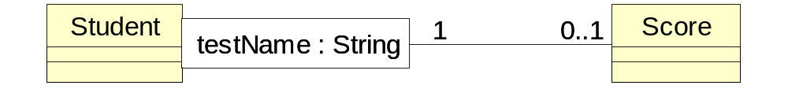
Qualified Associations
The qualifier function as an index (or key) to objects on the other side of the link when you instantiate the association.
Example: Let say you want to record the scores achieved by a student; For each test you have a score and each test is identified with a test name:

Slide 36
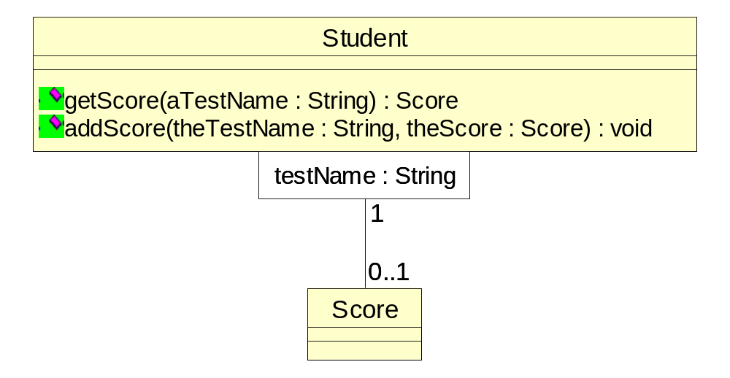
Qualified Associations Continues
Given a student and a test Name you can find the score the student has achieved.
To access the score the student might have the following operations:
The implementation of
the association might be
a hash table or some sort
of associative array:
class Student{
HashTable scores;...
}

Slide 37
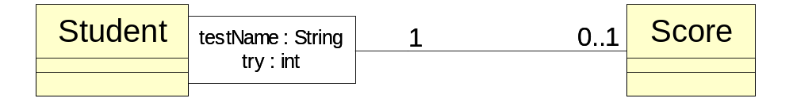
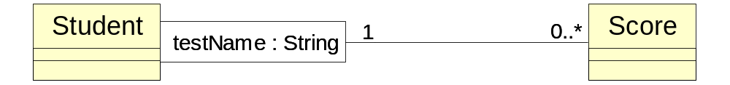
Qualified Associations Continues
If the same student can do the same test many times and you want to recorded the tries and the order of the tries:
If the same student can do the same test many times and all scores are of interest, but not the order of the tries:

Slide 38
Derived Element
A derived element is computed from other elements. A derived element is marked with a slash in front of the name.
follows
Student
Course
/teaches student
teaches course
Lecturer
When you do analysis you might add it to make the model more clear.
At design-level the derived element is an optimization - it represent something that could have been derived, but is represented explicit (may be with a efficiency penalty keeping it updated).

Slide 39
Derived Element Examples [5]
employer
Company
Department
1
*
1
employer
1
department
WorksForDepartment
/WorksForCompany
*
*
Person
{Person.employer =Person.Department.employer}
birthdate
/age
{age = currentDate - birtdate}

Slide 40
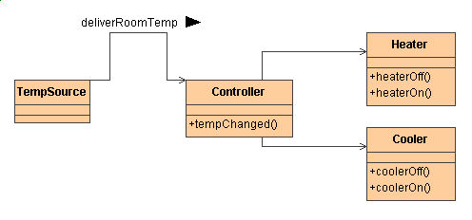
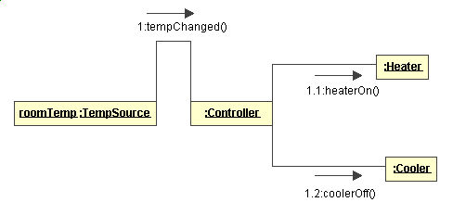
1. Interface Contra Class
Example: part of an air conditioning simulation system
Class diagram showing
the structure
Collaboration diagram
showing a possible
message sequence

Slide 41
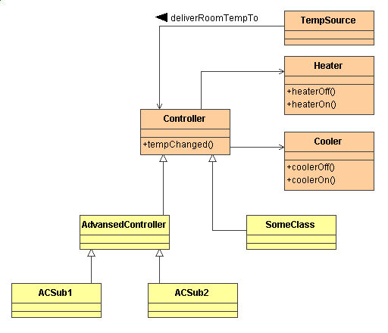
2. Interface Contra Class
What kind of classes can substitute the Controller class?
If you have single inheritance all subclasses of Controller can
take its place.
If you have a prefabricated class and you want to use this as a Controller, than you have a problem!

Slide 42
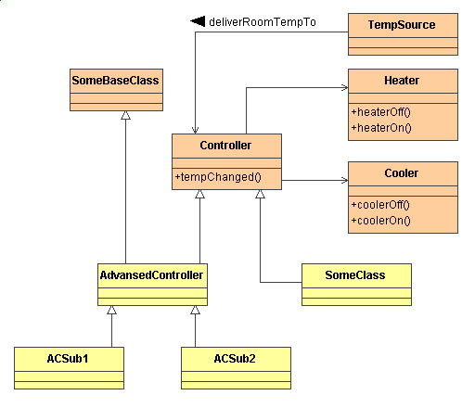
3. Interface Contra Class
What kind of classes can substitute the Controller class?
If you have multiple inheritance and you have a prefabricated class that you want to use as a Controller: make a new class that
inherit from Controller and from
the prefabricated class.

Slide 43
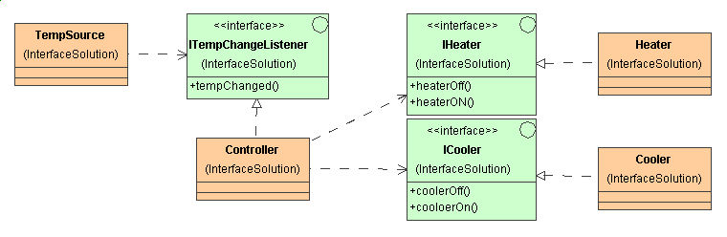
4. Interface Contra Class
A new solution where interfaces are used:
Class diagram
No associations directly
to a class, everything is
going through explicit
defined interfaces.

Slide 44
5. Interface Contra Class
What kind of classes can substitute the Controller class?
Now all classes that implements ITempChangeListener, uses IHeater and uses ICooler can be used as a controller.
The specification is now separated from the implementation!
You achieve much the same with abstract classes and multiple inheritance, but multiple inheritance is not recommended!

Slide 45
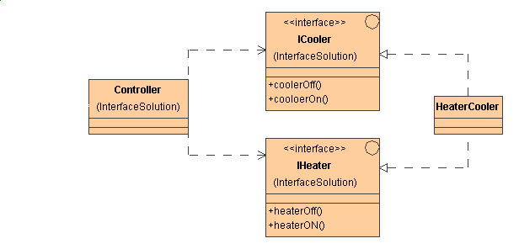
6. Interface Contra Class
Use of interfaces advocates a new way of thinking, now focus is on roles and not on object types.
Often a role can be filled by objects that are very different.
On operation can by itself be seen as an interface; by putting coherent operations
into the same interface (you
can also use inheritance),
you put more information
into the modell.

Slide 46
References
[1] Ole Lehrmann Madsen, Birger Møller-Pedersen and Kristen Nygaard: Object-Oriented Programming in the Beta Programming Language.
Addison-Wesley, 1993
[2] Martin Fowler with Kendall Scott: UML Distilled.
Addison-Wesley, 1997
[3] James Rumbaugh, Michael Blaha, William Premerlani, Frederick Eddy and William Lorenzen: Object-Oriented Modeling and Design.
Prentice Hall, 1991
[4] Grady Booch, James Rumbaugh, Ivar Jacobson: The Unified Modeling Language User Guide.
Addison-Wesley, 1999
[5] James Rumbaugh , Ivar Jacobson, Grady Booch: The Unified Modeling Language Reference Manual.
Addison-Wesley, 1999
Terry Quatrani: Visual Modeling with Rational Rose and UML.
Addison-Wesley, 1998
Rational software: http://www.rational.com/uml/documentation.html

